Slide 1
《算法分析与设计》
Analysis and Design of Computer Algorithms
中南大学计算机学院
School of Computer Science and Engineering
Central South University
主讲：李敏
联系方式：limin@mail.csu.edu.cn
csu.limin@gmail.com

Slide 2


Greedy algorithm
良禽择木而栖，良将选主而事。
公司雇人要雇最能干的人，大学招生想招最好的学生，各种评优选优或者选“N大杰出×××”等活动。
人类似乎永远在追求最好的东西，无一不散发出贪婪的气味。
这种按照某种标准总是挑选最接近该标准的人或物的做法就是贪婪策略。

Slide 3
Greedy
围棋
要想在高手较量中取胜，每一步棋都需要考虑随后的很多步。谁考虑的步数多，谁取胜的可能性就大。
如果一个棋手只看眼前的效果，则这个棋手恐怕得经常输棋。
在找男女朋友时，我们总是试图找所认识人里面的最优秀者，而对于我们不认识的人则不加考虑。
如此这样下去，就可以获得最优结果（假定人的寿命无限长）。
每步只看眼前效果最好的做法就是贪婪。
以贪婪作为决策基础的算法就是贪婪算法。

Slide 4
Greedy Algorithms
A greedy algorithm makes a locally optimal choice in the hope that this choice will lead to a globally optimal solution.
The choice made at each step must be:
  Feasible
    Satisfy the problem’s constraints
  locally optimal
    Be the best local choice among all feasible choices
  Irrevocable
    Once made, the choice can’t be changed on subsequent steps.
Notes:
For many problems, using dynamic programming to determine the best choice is
an overkill. Simpler, more efficient algorithm will do.
A greedy algorithm always makes the choice that looks best at the moment.
That is, it makes a locally optimal choice in the hope that this choice will lead to
a globally optimal solution.
The greedy algorithm is quite powerful and works well for a wide range of problems.

Slide 5
Change Making Problem
How to make 63 cents of change using coins of denominations of 25, 10, 5, and 1 cent so that the total number of coins is the smallest?
The idea:
  make the locally best choice at each step.
Is the solution optimal?

Slide 6
Do greedy algorithms always yield optimal solutions?
  Example: change making problem with a denomination set of 11, 5 and 1 and to make 15 cents of change.

Slide 7
Minimum Spanning Tree (MST)
Spanning tree of a connected graph G: a connected acyclic subgraph (tree) of G that includes all of G’s vertices.
Minimum Spanning Tree of a weighted, connected graph G: a spanning tree of G of minimum total weight.
Example:
4
3
1
1
6
2
4
2
3
Notes:
Minimum spanning trees are used throughout today's modern society.
For instance, one standard application would be phone network design.
Let's say you own a business with several offices and you want to lease phone lines
to connect them up with each other. The phone company charges different amounts
of money to connect different pairs of cities. You want a set of phone lines
that connects all of your offices with a minimum total cost. It should be
implemented as an MST because if a network is a tree then you will have
all of the cities connected without wasting money connecting cities unnecessarily.

Slide 8
Prim’s MST algorithm
Basic idea
  Choose an arbitrary vertex v0, and put it in T.
  Adding the minimum weight edge e=(u, v) among the edges with one vertex in T and the other in V-T.
  Put v in T.
  stops when all vertices are included

Slide 9
Prim’s MST algorithm
Prim(G)
VT={v0};
ET=Ф;
For i=1 to n-1 do
find a minimum weight edge e*=(u*, v*) among
all the edges (u, v) such that u is in T and v is in V-T;
VT=VT∪{v*};
ET=ET∪{e*};
4. Return ET.

Slide 10
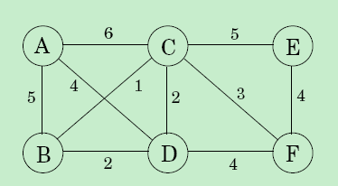
Prim’s MST algorithm
Start with A.

Slide 11
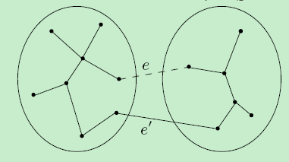
Prim’s MST algorithm
Correctness of Prim algorithm

Slide 12
Prim’s MST algorithm
Prim(G)
For all v∈V do
cost(v)= ∞; prev(v)=nil;
VT={v0}; cost(v0)=0;
Q=makequeue(V);
while Q ≠ ∅ do
v= Extract-Min(Q) //remove the nearest vertex from Q
for each (v, z)∈E do
if cost(z)>w(v, z) then
cost(z)=w(v, z);
prev(z)=v;
decreasekey(Q, z);

Slide 13
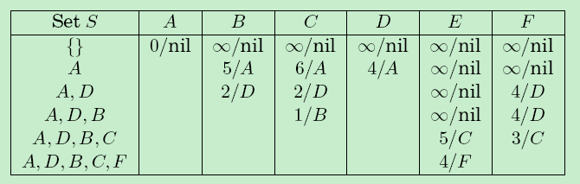
Prim’s MST algorithm
Start with A.

Slide 14
Prim’s algorithm efficiency
Need priority queue for locating the nearest vertex
  Use unordered array to store the priority queue:
Efficiency: Θ(n²)
  use min-heap to store the priority queue
  Efficiency: For graph with n vertices and m edges:
(n + m) logn

Slide 15
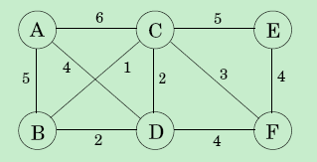
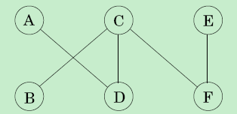
Another Greedy Algorithm for MST: Kruskal
Greedy rule:
Repeatedly add the next lightest edge that doesn't produce a cycle.
Notes:
mlogm

Slide 16
Kruskal’s Algorithm
ALGORITHM Kruscal(G)
1. Sort E in nondecreasing order of the edge weights
w(e_{i1}) <= … <= w(ei_{m})
2. E_{T} ＝ ∅; ecounter ＝ 0 //initialize the set of tree edges and its size
3. k ＝ 0
4. while encounter < |V| - 1 do
k ＝ k + 1
if E_{T} U {ei_{k}} is acyclic
E_{T ＝} E_{T} U {ei_{k}} ; ecounter ＝ ecounter + 1
5. return E_{T};
;
Notes:
Always choosing the closest vertex in Q to add to VT→ greedy.

Slide 17
Another Greedy Algorithm for MST: Kruskal
some implementation details
For the current chosen edge (u, v), u and v lie in different components
the corresponding components need to be merged.
What kind of data structure supports such operations?
model the algorithm‘s state as a collection of disjoint sets
Notes:
mlogm

Slide 18
Another Greedy Algorithm for MST: Kruskal
some implementation details
makeset(x): create a singleton set containing just x
find(x): to which set does x belong?
union(x, y): merge the sets containing x and y
Notes:
mlogm

Slide 19
Another Greedy Algorithm for MST: Kruskal
Kruskal(G)
For all u∈V do
makeset(u);
2. X={∅};
3. Sort the edges E by weight;
4. For all edges (u, v) ∈ E in increasing order of weight do
if find(u) ≠find(v) then
add edge (u, v) to X;
union(u, v);
How many makeset, find, union operations?
|V| makeset, 2|E| find, |V|-1 union operations.
Notes:
mlogm

Slide 20
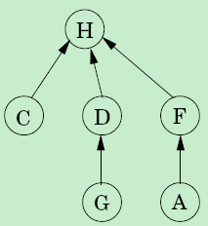

Another Greedy Algorithm for MST: Kruskal
How to manage the disjoint sets( data structure)?
How to store a set?
Directed tree
{B, E}
{A, C, D, F, G, H}
Notes:
mlogm

Slide 21
Another Greedy Algorithm for MST: Kruskal
Root: its parent pointer points to itself.
Rank: the height of subtree hanging from that node.
Makeset(x)
P(x)=x;
Rank(x)=0;
Constant time operation
Find(x)
While x ≠P(x) do
x=P(x);
2. return(x);
The time taken is proportional to the height of the tree.
Notes:
mlogm

Slide 22
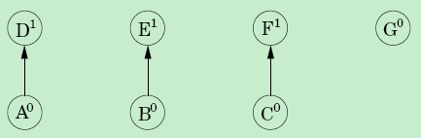
Another Greedy Algorithm for MST: Kruskal
After makeset(A), makeset(B), …, makeset(G).
After union(A,D), union(B,E), union(C, F).
Notes:
mlogm

Slide 23
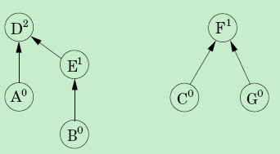
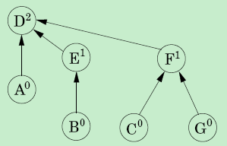
Another Greedy Algorithm for MST: Kruskal
After union(C,G), union(E,A).
After union(B,G).
Notes:
mlogm

Slide 24
Another Greedy Algorithm for MST: Kruskal
Properties of node’s Rank.
Property 1: For any x, rank(x) < rank(P(x)).
Property 2: Any root node of rank k has at least 2^{k} nodes in its tree.
Property 3: If there are n elements overall, there can be at most n/2^{k} nodes of rank k.
Notes:
mlogm

Slide 25
Another Greedy Algorithm for MST: Kruskal
Kruskal(G)
For all u∈V do
makeset(u);
2. X={∅};
3. Sort the edges E by weight;
4. For all edges (u, v) ∈ E in increasing order of weight do
if find(u) ≠find(v) then
add edge (u, v) to X;
union(u, v);
Running time analysis
Sorting the edges: O(|E|log|V|)
Union and Find operations: O(|E|log|V|)
Notes:
mlogm

Slide 26
Another Greedy Algorithm for MST: Kruskal
Running time analysis
Sorting the edges: O(|E|log|V|)
Union and Find operations: O(|E|log|V|)
how can we perform union's and find's faster than log n?
Amortized Analysis
Notes:
mlogm

Slide 27
Another Greedy Algorithm for MST: Kruskal
Amortized Analysis（摊销分析）
中国很多古装电影里不时会出现这样一个镜头：某大臣因办某件事情失败，被皇帝怪罪，这时旁边的人就会求情说，看在该大臣曾经辅佐先帝或立下汗马功劳等，希望能够从轻发落或者免除死罪。
请求的意思就是：如果将其一生摊开来看，这一次失利并不显得怎样最大恶极。
这就是摊销。即将某件事情摊销到所有的事情上来看或者分析。
Notes:
mlogm

Slide 28
Another Greedy Algorithm for MST: Kruskal
Amortized Analysis（摊销分析）
对于一家上市公司，它的各种报告里经常出现摊销（Amortized)这个字眼。
例如，公司会将某次购买大额设备的费用分摊到多个季报里面，从而使得每个季报所显示的开销较低，避免季报之间盈利的大幅振动。
Notes:
mlogm

Slide 29
Another Greedy Algorithm for MST: Kruskal
reduce the time for Find operation
Find(x)
While x ≠P(x) do
x=P(x);
2. return(x);
keep the trees short
change all these pointers so that they point directly to the root
path compression
Notes:
mlogm

Slide 30
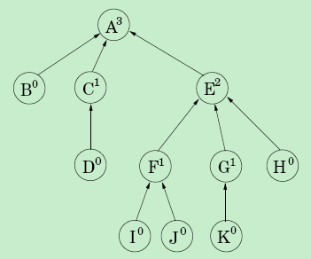
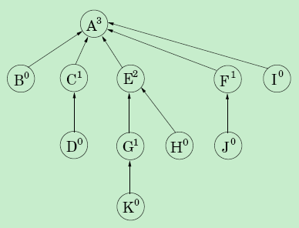
Another Greedy Algorithm for MST: Kruskal
Find(I)
Notes:
mlogm

Slide 31
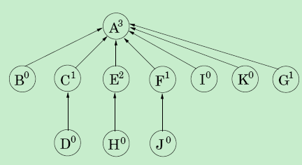
Another Greedy Algorithm for MST: Kruskal
Find(K)
Notes:
mlogm

Slide 32
Another Greedy Algorithm for MST: Kruskal
Find(x)
While x ≠P(x) do
x=P(x);
2. return(x);
How to achieve path compression?
Find(x)
If x≠P(x) then
P(x)=Find(P(x));
2. return P(x);
Notes:
mlogm

Slide 33
Another Greedy Algorithm for MST: Kruskal
The benefit of this simple alteration is long-term rather than instantaneous
sequences of find and union operations
O(logn)
barely more than O(1)
Notes:
mlogm

Slide 34
Another Greedy Algorithm for MST: Kruskal
For the data structure used, divide all nodes into two types:
Root nodes;
Nodes inside the trees.
Find operations only touch the inside nodes of the trees.
Union operations only work on the root nodes.
Path compression has no effect on union operations.
Notes:
mlogm

Slide 35
Another Greedy Algorithm for MST: Kruskal
Path compression has no effect on union operations.
Rank of root nodes are unchanged.
What about nonroot nodes?
For nonroot nodes, its rank never changed.
the ranks of all nodes are unchanged by path compression
Notes:
mlogm

Slide 36
Another Greedy Algorithm for MST: Kruskal
Each group is of the form: (k+1, k+2,…, 2^{k})
How many groups are there?
Log*n: the number of successive log operations bringing n down to 1.
Log*1000=4. loglogloglog1000≤1.
Notes:
mlogm

Slide 37
Another Greedy Algorithm for MST: Kruskal
In a sequence of find operations, some may take longer than others.
We'll bound the overall running time using Amortized Analysis.
m Find operations
Our objective: O(mlog*n+nlog*n)
Notes:
mlogm

Slide 38
Another Greedy Algorithm for MST: Kruskal
m Find operations
Our objective: O(mlog*n+nlog*n)
Give each node a certain amount of pocket money.
Total money doled out is at most nlog*n dollars.
How to dole out money?
a node receives its allowance as soon as it ceases to be a root.
If its rank lies in the interval {k+1, …, 2^{k}}, the node receives 2^{k} dollars.
Notes:
mlogm

Slide 39

Another Greedy Algorithm for MST: Kruskal
If its rank lies in the interval {k+1, …, 2^{k}}, the node receives 2^{k} dollars.
The number of nodes with rank>k is bounded by:
the total money given to nodes in this particular interval is at most n dollars,
There are log*n intervals, the total money distributed to all nodes is ≤nlog*n.
Notes:
mlogm

Slide 40
Another Greedy Algorithm for MST: Kruskal
For Find operation, this chain of nodes up to the root
Nodes x on the chain fall into two categories:
the rank of P(x) is in a higher interval than the rank of x;
(2) P(x) lies in the same interval with x.
For the first type nodes:
How many are there?
log*n
For those nodes, take at most O(log*n) to handle.
Notes:
mlogm

Slide 41
Another Greedy Algorithm for MST: Kruskal
The remaining nodes:
whose parents' ranks are in the same interval as theirs
each time x pays a dollar, its parent changes to one of higher rank.
if x's rank lies in the interval {k+1, …, 2^{k}}, it has to pay at most 2^{k} dollars before its parent's rank is in a higher interval
whereupon it never has to pay again.
m Find operations : O(mlog*n+nlog*n)
Notes:
mlogm

Slide 42
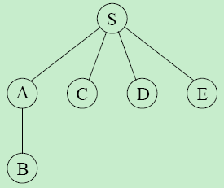
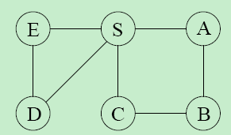
Dijkstra’s algorithm
Shortest Path problem:
Given a weighted graph G=(V, E), a vertex s, find the shortest path from s to other vertices.
For the graph without weight or with same weight:
Breadth-First Search.
Notes:
mlogm

Slide 43
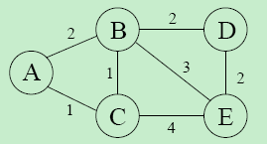
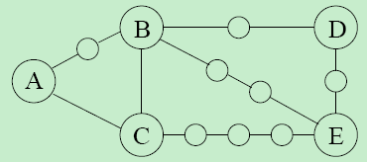
Dijkstra’s algorithm
For the general weighted graph
How to apply Breadth-First Search to solve the shortest path problem?
converting G into something BFS can handle.
Notes:
mlogm

Slide 44
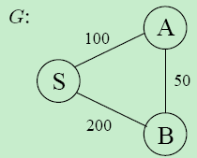
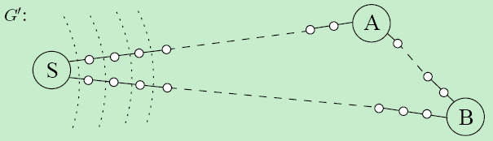
Dijkstra’s algorithm
For the general weighted graph
set two alarms
one for node A, set to go off at time T = 100
one for B, at time T = 200.
Notes:
mlogm

Slide 45
Dijkstra’s algorithm
one for node A, go off at T = 100
one for B, at time T = 200.
T = 100, alarm goes off, A has been discovered
the estimated time of B is adjusted to T = 150
change its alarm
Notes:
mlogm

Slide 46
Dijkstra’s algorithm
Set an alarm clock for node s at time 0;
For each neighbor u of s, set an alarm goes off at T (T is the distance from s to u).
An alarm goes off at time Ti, for node v,
The distance from s to v is Ti;
For each neighbor x of v in G
if there is no alarm for x, set one for time
Ti+w(v, x);
If x’s alarm is set for later than Ti+w(u,v), then
reset it to Ti+w(u, v);
Notes:
mlogm

Slide 47
Dijkstra’s algorithm
Dijkstra(G, s)
1. For all u∈V do
dist(u)=∞;
P(u)=nil;
2. Dist(s)=0;
3. H=makequeque(V);
4. While H is not empty do
u=deletemin(H);
for all edges (u, v) ∈E do
if dist(v)>dist(u)+w(u,v) then
dist(v)=dist(u)+w(u,v);
P(v)=u;
decreasekey(H, v);
Notes:
mlogm

Slide 48
Dijkstra’s algorithm
Prim(G)
For all v∈V do
cost(v)= ∞; prev(v)=nil;
VT={v0}; cost(v0)=0;
Q=makequeue(V);
while Q ≠ ∅ do
u = Extract-Min(Q)
for each (v, z)∈E do
if cost(z)>w(v, z) then
cost(z)=w(v, z);
prev(z)=v;
decreasekey(Q, z);
Notes:
mlogm

Slide 49
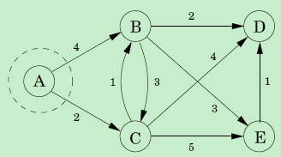
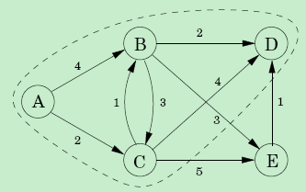
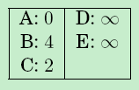
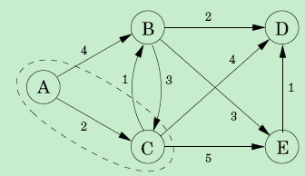


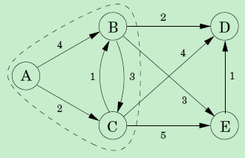
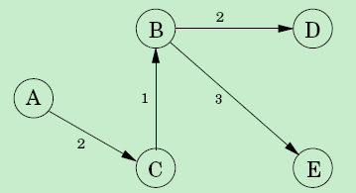
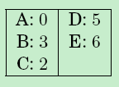
Dijkstra’s algorithm
Notes:
mlogm

Slide 50
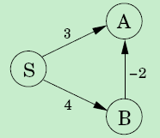
Dijkstra’s algorithm
Negative edges
dist(v)=min(dist(v), dist(u)+w(u,v)}
Notes:
mlogm

Slide 51
Dijkstra’s algorithm
Bellma-Ford(G, s)
1. For all u∈V do
dist(u)=∞;
P(u)=nil;
2. Dist(s)=0;
3. Repeat |V|-1 times
for all e=(u, v) ∈E do
dist(v)=min(dist(v), dist(u)+w(u,v)};
Notes:
mlogm

Slide 52
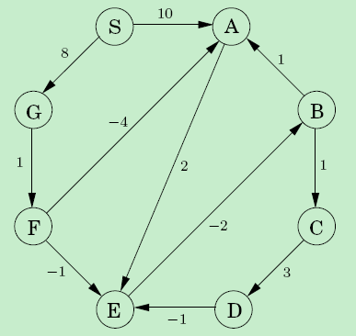
Dijkstra’s algorithm
Negative cycles
How to detect a negative cycle?
-4
Notes:
mlogm

Slide 53
Dijkstra’s algorithm
Bellma-Ford(G, s)
1. For all u∈V do
dist(u)=∞;
P(u)=nil;
2. Dist(s)=0;
3. Repeat |V|-1 times
for all e=(u, v) ∈E do
dist(v)=min(dist(v), dist(u)+w(u,v)};
4. for all e=(u, v) ∈E do
if dist(v) is changed then
return “negative cycle”;
Notes:
mlogm

